Slide 1


THE 2023 BOARD REMUNERATION AND
GOVERNANCE REPORT
Executive and Non-Executive Director Compensation | Board Performance and Composition
| Board Independence | Gender Analysis

Slide 2






A STUDY OF TRENDS IN BOARD COMPENSATION AND PAY STRUCTURE
The 2023 Board Remuneration and Governance Report, complemented by a cloud-based benchmarking tool, AgileX, enables in-depth, cross-tabulated analysis of Director-level compensation trends and Board-governance structures across listed and unlisted companies. This edition covers 17,790 companies and over 100,000 executive and non-executive director positions. The report covers the following areas:
Board Governance Metrics
•Board size trends •Number of IDs and NEDs •Share of IDs on company boards •Board independence •Promoter presence on the Board •Total board pay •Number of board meetings held each year •What makes ESG companies different?
Executive Directors’ Compensation
Compensation trends for Executive Directors from FY19-23 •Total pay (means, medians and percentile values) by designation and pay ranges •Pay composition •Changes in pay, FY19-23 •Lists of the highest paid CMDs, CEOs and CFOs
Gender Diversity and Equality
Male vs female representation across executive levels • Company with no female representation •Gender-wise pay split by level • Changes in pay, FY19-23 •Gender-wise pay composition
Non-Executive Directors’ Compensation
NED and Non-Executive Chairman pay trends •Composition and splits by revenue, profit, company age, ownership, market cap, sector

Slide 3






DETAILED PEER COMPARISONS & CROSS TABULATION
17,790 listed and unlisted companies studied
In addition to sector, revenue, profits and ownership splits, detailed cross-tabulations are made on the basis of the following parameters:
Market cap: Large cap, mid cap, small cap, micro cap and unlisted companies
Company Age group: <Pre-liberalisation (<1991); Liberalisation to GFC (1991-2007); Post GFC (2008 and after)
Gender
Environmental, social and governance (ESG) criteria: Large and mid-cap ESG-rated and non-ESG-rated companies
5 years of compensation trends
7 Exec and Non-Exec positions covered
>100,000 Executives/Directors reviewed
11 sectors & 40 sub-sectors analysed
7 way tabulations/ cross-tabulations
The report is based on latest data (FY23) that is collated and distilled from company annual reports, which are available in the public domain, and from filings with the Ministry of Corporate Affairs (MCA), Government of India.

Slide 4
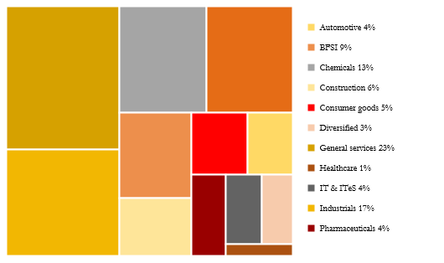
IN-DEPTH COVERAGE ACROSS SECTORS, OWNERSHIP LEVELS AND MORE
Sectors
Revenue (FY23)
Market Cap
Ownership

Slide 5

ENABLING CXOS WITH THOUGHT PROVOKING INSIGHTS
The 60+ page report helps to:
Identify trends in top-executive and Board-level pay
Understand the composition of Boards across India
Establish benchmarks for compensation to Directors based on leading industry practices and detailed peer comparisons
Determine correlations between pay and performance
Recognise gender pay gaps across executive levels

Slide 6
HIGHLIGHTS AND KEY FINDINGS FROM THE REPORT

Slide 7
BOARD SIZE TREND
Board size correlates strongly with market cap for both private companies and PSUs.
Across most categories of firms, both private and PSU boards started seeing an increase in their size FY22 onwards.
Board Size – Trend
(by ownership)

Slide 8
NUMBER OF INDEPENDENT DIRECTORS
Private-sector companies generally have a higher share of IDs on the Board than PSUs.
The share of IDs on company board tends to fall as the market-cap decreases for private sector companies.
Share of IDs on Company Boards
FY23

Slide 9
TOTAL PAY
CEOs in the private sector are the highest paid, with an average of Rs 38.7 million in compensation.
CFOs earned Rs 10.7 million – 28% of what CEOs earned and 29% less than EDs.
Non-Executive Chairpersons earned Rs 6.3 million, Company Secretaries Rs 3.1 million and NEDs Rs 1.2 million.
Private Sector
Mean (Rs million)

Slide 10
CHANGE IN PAY
Private-sector CMD pay has risen from Rs 22.6 million in FY19 to Rs 32.6 million in FY23.
CEOs on average received Rs 38.7 million in pay in FY23 – ~70% more than in FY19.
Non-Exec Chairmen continue to see the greatest volatility in pay, but on average, their pay has increased in the last five years, from Rs 5.0 million to Rs 6.3 million.
Private Sector

Slide 11
PAY COMPOSITION FY23
PSU pay structures vary far less than those in the private sector and skew heavily towards the fixed-pay side.

Slide 12
EXECUTIVE PAY RATIOS FY23
CEOs generally earn a bit more than CMDs, but ~3 times as much as CFOs
With the exception of foreign MNCs (~40% less) and unlisted firms (40% more), CEO and CMD pay is broadly equal across companies by size and ownership.

Slide 13
GENDER PAY GAPS
Substantial gender-related pay gaps exist across designations in the private sector, with men earning more than twice as much as women in some positions.
The pay gaps in the PSU world is comparatively lesser with the highest being almost double pay for males than females in CS positions.
The gap between the mean pay of NEDs in the private sector is considerably large.
Private Sector
PSUs*
Mean (Rs million)
Mean (Rs million)

Slide 14
GENDER DIVERSITY ON THE BOARD
The proportion of companies with no female directors on the Board fell from 4.7% in FY16 to below 4% in FY19, and further to 3.1% in FY23 in private listed companies. This suggests that diversity is starting to receive some attention.
% Companies with No Female Directors

Slide 15
OTHER HIGHLIGHTS
The average aggregate compensation paid to Board members is Rs 59.6 mn but this rises sharply with company size, to an average of Rs 440 mn among large caps.
Compensation levels, across all executive positions, rose sharply in FY23.
Private sector CEOs were the highest paid with an average CTC of Rs 38.7 mn, surpassing the mean CMD CTC.
NEDs earn, on average, 21% of their compensation as variable pay in the private sector, compared to 3% in PSUs.
Women remain grossly under-represented in C-Suite and Board positions. Private and PSU Boards have only 2 female Directors on average, as opposed to ~11 male Directors.
The above highlights are some high-level examples. The full report contains detailed insights, cross-tabulations and role specific segmentations.

Slide 16
TABLE OF CONTENTS
Introduction and Overview
Data sources and definitions
Glossary of terms
Company demographics
Executive summary
Company Board Metrics
Board size and trends
Number of NEDs
Number of Independent Directors
Board independence
Promoter presence on the board
Number of board meetings
What makes ESG-compliant companies different?
Cost of running a board
*by sector, market capitalisation, ownership, company age, ESG compliance, revenue band

Slide 17
TABLE OF CONTENTS
Executive Directors’ Compensation
Total pay (FY19-23) by levels: CMDs, CEOs, CFOs, Executive Directors, Company Secretaries
Total pay: Means, medians, 25th, 75th and 90th percentile levels
Pay trends and changes in total pay: FY19-23
Pay comparisons by market cap, company age, revenue, sector, ownership
Private sector vs PSU pay comparisons
Composition of pay by levels: fixed pay (and its components), variable pay (and its components, including ESOPS)
Executive pay ratios: CMD:CEO, CFO:CEO
Pay gaps: FY19-23 trend
Pay comparisons FY23 by size and ownership
Highest paid CMDs, CEOs, CFOs
*by sector, market capitalisation, ownership, company age, ESG compliance, revenue band

Slide 18
TABLE OF CONTENTS
Non-Executive Directors’ Compensation
Total pay (FY19-23) by levels: Non-Executive Directors and Non-Executive Chairman
Total pay: Means, medians, 25th, 75th and 90th percentile levels
Pay trends and changes in total pay: FY19-23
NED and Non-Executive Chairman pay comparisons by market cap, ownership, sector, revenue
Composition of pay: fixed pay (and its components), variable pay (and its components, including ESOPS)
Private sector vs PSU pay comparisons
Gender Diversity and Equality
Male-Female representation by level
Companies with no female representation
Gender-wise pay by level
Gender-wise pay composition
*by sector, market capitalisation, ownership, company age, ESG compliance, revenue band

Slide 19
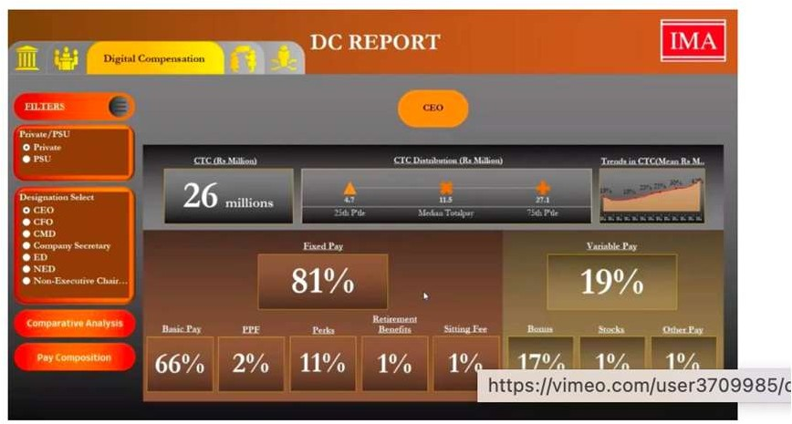
ACCESS DIRECTOR COMPENSATION AND GOVERNANCE METRICS ON AGILEX
AgileX is a cloud-based benchmarking tool that offers customised benchmarking data on executive and non-executive director compensation and Board governance metrics. This subscription-based tool offers first-of-its-kind features:
Interactive: Charts and data points change with a click
True-peer benchmarks: Use custom filters (like company size, sector, workforce, etc) to find comparable data from your true peers
Custom output: Choose specific parameters to create your
own custom analysis
Reliable: Based on authentic data collected from top companies in India
Relevant: Data is refreshed regularly to keep insights relevant
Secure: Only aggregated data is shared to ensure full data privacy
AgileX in action
(click here to see the video)S

Slide 20



SUBSCRIPTION FEES*
 | IMA Forum members | Non-members
The 2023 Board Remuneration & Governance Report (PDF copy) | Rs 30,000 + GST | Rs 50,000 + GST
AgileX: 12-month subscription to our cloud-based tool | Rs 40,000 + GST | Rs 60,000 + GST
Bundle offer: PDF report copy + 12 month subscription to Agilex | Rs 60,000 + GST | Rs 80,000 + GST
Bundled offer: Now get access to IMA’s proprietary cloud-based tool, AgileX for detailed cuts and custom analysis
To purchase a copy, please click here
Our cloud-based tool enabling detailed cuts and customised analysis of Executive Compensation and Board and Gender Diversity Metrics
PDF Report
* Subscribers to the 2022 edition of the report are eligible for a 15% additional discount on these fees

Slide 21












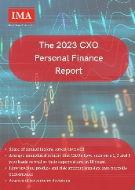
OUR PORTFOLIO OF RESEARCH REPORTS
Human Resources
Finance
Marketing
The Accounts Closing Benchmarking Study, 2020
Covid-19 Impact on Compensation and Hiring
The 2023 Mental Health Insights Report
The 2019 Diversity and Inclusion Benchmarks Report
FY22 Attrition Benchmarking Study
Finance Department Performance Benchmarks
The Accounts Closing Benchmarking Study, 2020
The 2020 Digital Marketing Benchmarking Survey
Economic and Thematic Studies
Other
Indian Agriculture: An Analytical Assessment
The India Employment Report 2017
Diversity Underlying Unity: A Study of India's States 2018
The India Consumption Report 2016
CXO Diaries:
Life after Covid-19
The 2023 CXO Personal Finance Report

Slide 22
ABOUT IMA INDIA
The country’s largest peer platform for senior executives
More than 2,000 clients – CEOs and functional heads – from over 1,200 member companies, Indian and global
Extensive capabilities in macroeconomic, industry and management research
Strong in-house research capability with access to senior industry practitioners, domain specialists and other stakeholders
A successful track record of over 29 years
28+
Years in Business
2,000+
CXO Clients
1,200+
Member Companies
76%
of NSE 50 Brands
6
Cities of operations across India

